Slide 1




Face Alignment by Explicit Shape Regression
Xudong Cao Yichen Wei
Fang Wen Jian Sun
Visual Computing Group
Microsoft Research Asia

Slide 2
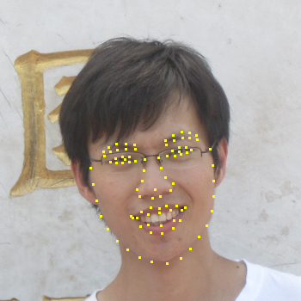
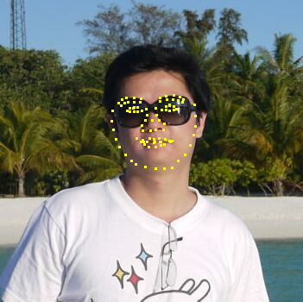
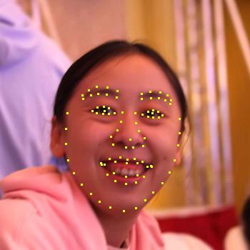
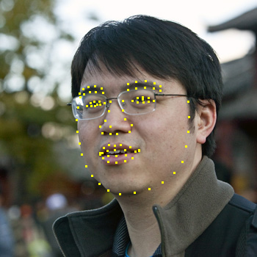
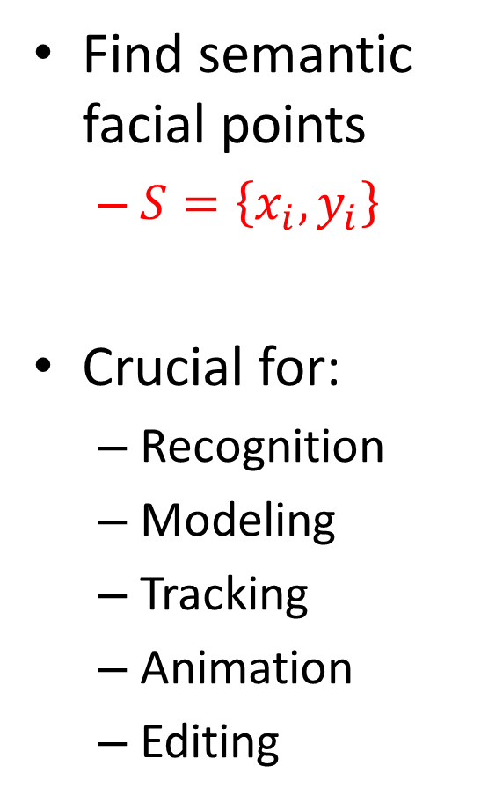
Problem: face shape estimation
Find semantic facial points
$S=\left\{x_{i},y_{i}\right\}$
Crucial for:
Recognition
Modeling
Tracking
Animation
Editing

Slide 3

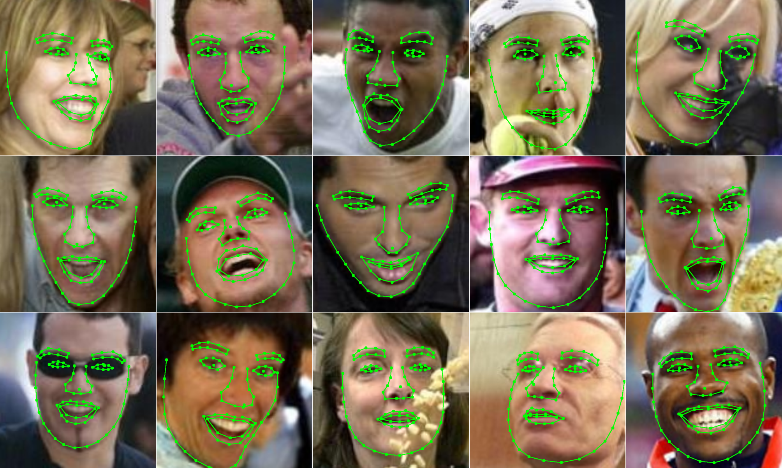
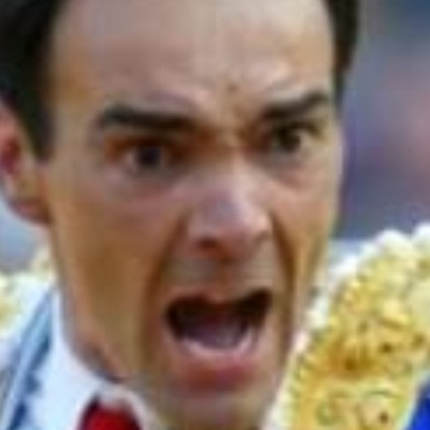


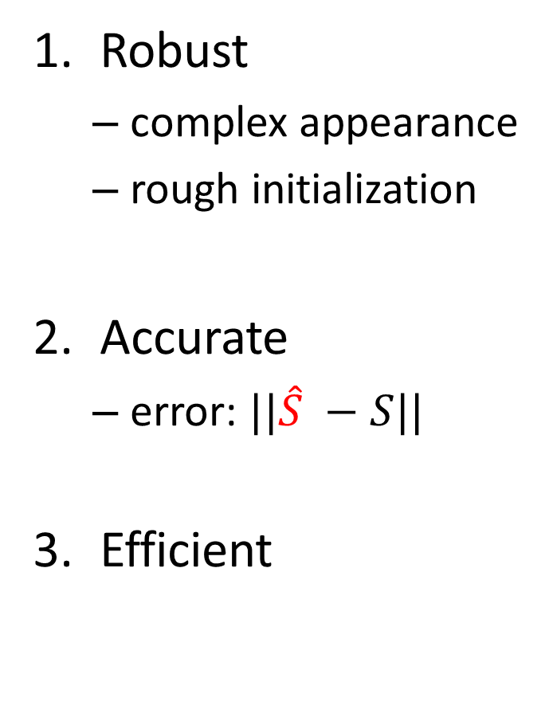
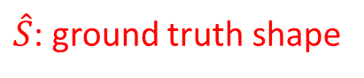
Desirable properties
Robust
complex appearance
rough initialization
Accurate
error: $||\hat{S} −S||$
Efficient
pose
expression
$\hat{S}$: ground truth shape
lighting
occlusion
training: minutes / testing: milliseconds

Slide 4
Previous approaches
Active Shape Model (ASM)
detect points from local features
sensitive to noise
Active Appearance Model (AAM)
sensitive to initialization
fragile to appearance change
[Cootes et. al. 1992]
[Milborrow et. al. 2008]
…
[Cootes et. al. 1998]
[Matthews et. al. 2004]
...
All use a parametric (PCA) shape model

Slide 5
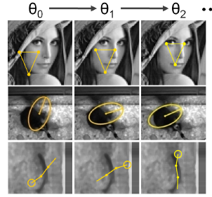
Previous approaches: cont.
Boosted regression for face alignment
predict model parameters; fast
[Saragih et. al. 2007] (AAM)
[Sauer et. al. 2011] (AAM)
[Cristinacce et. al. 2007] (ASM)
Cascaded pose regression
[Dollar et. al. 2010]
pose indexed feature
also use parametric pose model

Slide 6
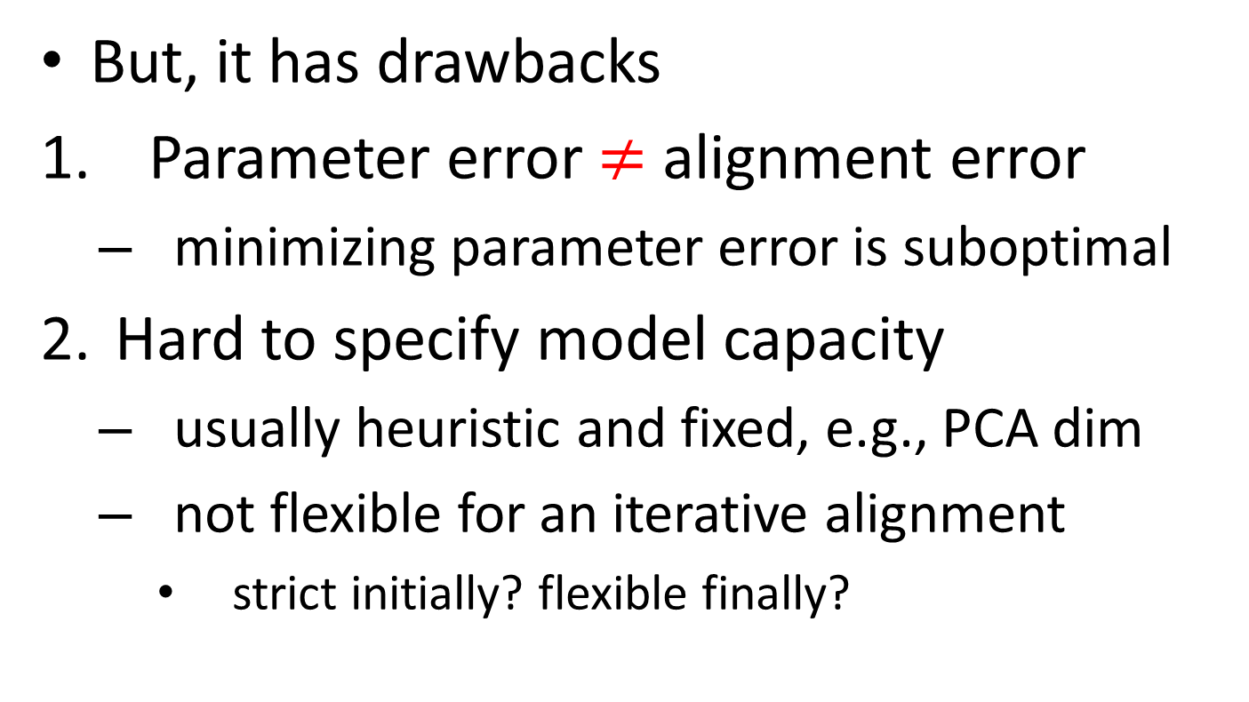
Parametric shape model is dominant
But, it has drawbacks
Parameter error $≠$ alignment error
minimizing parameter error is suboptimal
Hard to specify model capacity
usually heuristic and fixed, e.g., PCA dim
not flexible for an iterative alignment
strict initially? flexible finally?

Slide 7
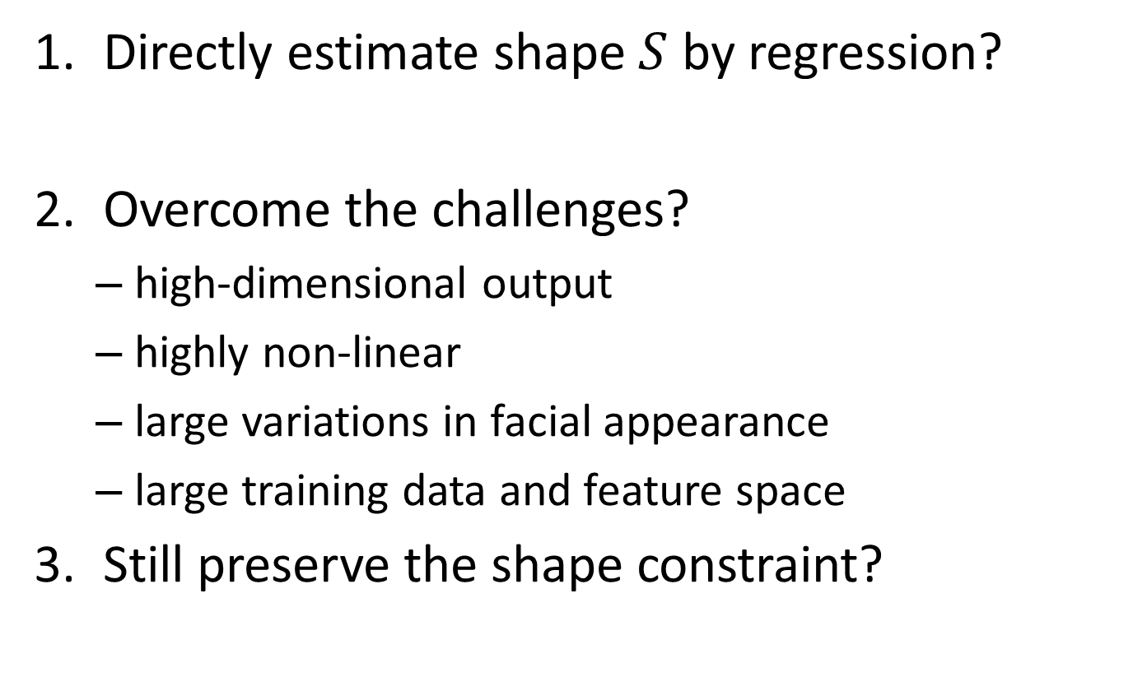
Can we discard a parametric model?
Yes
Directly estimate shape $S$ by regression?
Overcome the challenges?
high-dimensional output
highly non-linear
large variations in facial appearance
large training data and feature space
Still preserve the shape constraint?
Yes
Yes

Slide 8
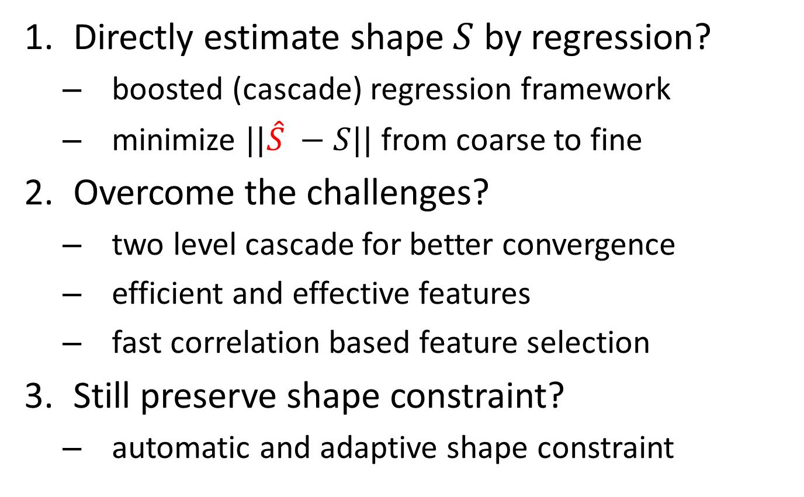
Our approach: Explicit Shape Regression
Yes
Directly estimate shape $S$ by regression?
boosted (cascade) regression framework
minimize $||\hat{S} −S||$ from coarse to fine
Overcome the challenges?
two level cascade for better convergence
efficient and effective features
fast correlation based feature selection
Still preserve shape constraint?
automatic and adaptive shape constraint
Yes
Yes

Slide 9


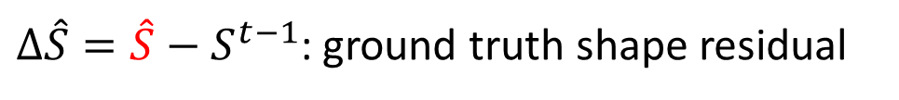
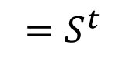
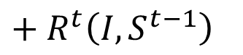
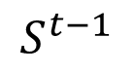

Approach overview
t = 0
t = 1
t = 2
…
t = 10
initialized from face detector
…
affine
transform
transform
back
$I$: image
$$S^{t−1}$$
$+ R^{t}\left(I,S^{t−1}\right)$
$${ =S}^{t}$$
Regressor $R^{t}$ updates previous shape $S^{t−1}$ incrementally
$R^{t}=\underset{R}{argmin}\left|∆\hat{S}−R\left(I,S^{t−1}\right)\right|$, over all training examples
$∆\hat{S}=\hat{S}−S^{t−1}$: ground truth shape residual

Slide 10
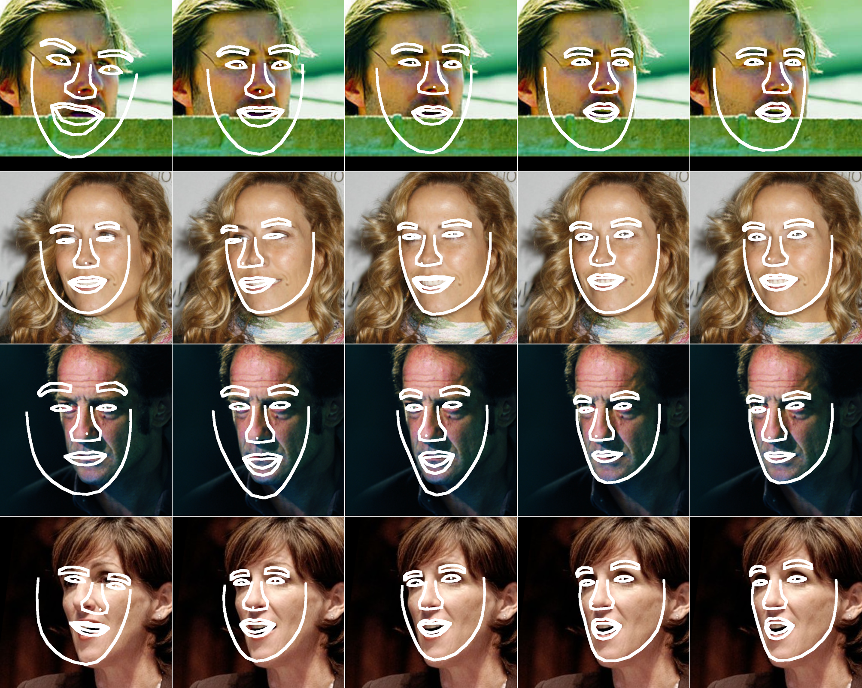

Slide 11
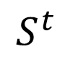
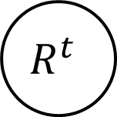
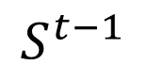


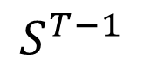

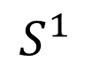
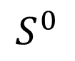
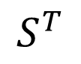
Regressor learning
$$S^{0}$$
$$R^{1}$$
$$S^{1}$$
$$S^{t−1}$$
$$R^{t}$$
$$S^{t}$$
$$S^{T−1}$$
$$R^{T}$$
$$S^{T}$$
…...
…...
What’s the structure of $R^{t}$
What are the features?
How to select features?

Slide 12
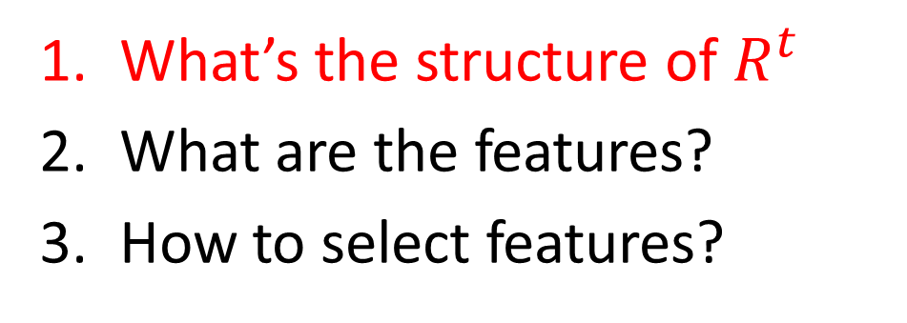
Regressor learning
$$S^{0}$$
$$R^{1}$$
$$S^{1}$$
$$S^{t−1}$$
$$R^{t}$$
$$S^{t}$$
$$S^{T−1}$$
$$R^{T}$$
$$S^{T}$$
…...
…...
What’s the structure of $R^{t}$
What are the features?
How to select features?

Slide 13
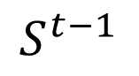

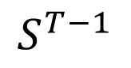


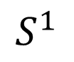

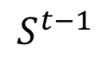
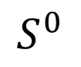
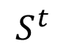
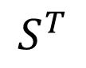

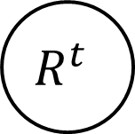
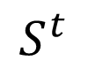

Two level cascade
$$×$$
too weak $R^{t}→$ slow convergence and poor generalization
a simple regressor, e.g., a decision tree
$$S^{0}$$
$$R^{1}$$
$$S^{1}$$
$$S^{t−1}$$
$$R^{t}$$
$$S^{t}$$
$$S^{T−1}$$
$$R^{T}$$
$$S^{T}$$
…...
…...
$$S^{t−1}$$
$$r^{1}$$
……
$$r^{k}$$
..….
$$r^{K}$$
$$S^{t}$$
two level cascade: stronger $R^{t}→$rapid convergence

Slide 14
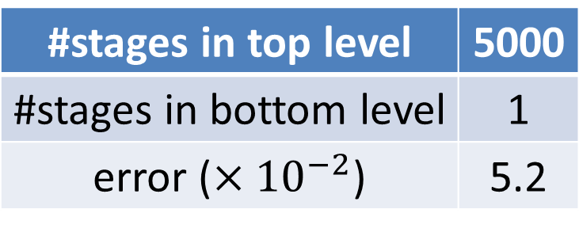
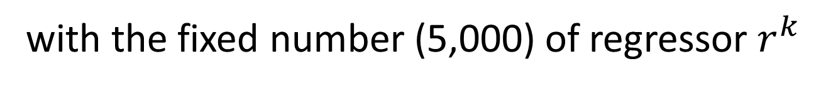
Trade-off between two levels
#stages in top level | 5000
#stages in bottom level | 1
error (${×10}^{−2}$) | 5.2
100
50
4.5
10
500
3.3
5
1000
6.2
with the fixed number (5,000) of regressor $r^{k}$

Slide 15
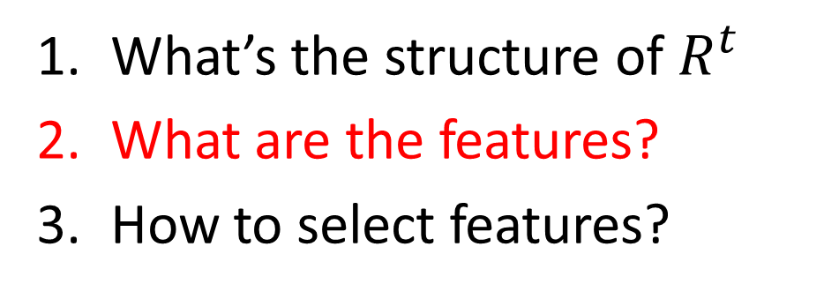
Regressor learning
$$S^{0}$$
$$R^{1}$$
$$S^{1}$$
$$S^{t−1}$$
$$R^{t}$$
$$S^{t}$$
$$S^{T−1}$$
$$R^{T}$$
$$S^{T}$$
…...
…...
What’s the structure of $R^{t}$
What are the features?
How to select features?

Slide 16
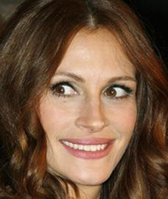


Pixel difference feature
Powerful on large training data
Extremely fast to compute
no need to warp image
just transform pixel coord.
[Ozuysal et. al. 2010], key point recognition
[Dollar et. al. 2010], object pose estimation
[Shotton et. al. 2011], body part recognition
…
$$I_{left eye}≈I_{right eye}$$
$$I_{mouth}≫I_{nose tip}$$

Slide 17
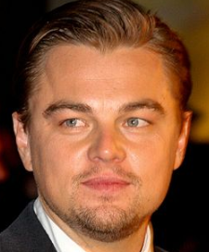
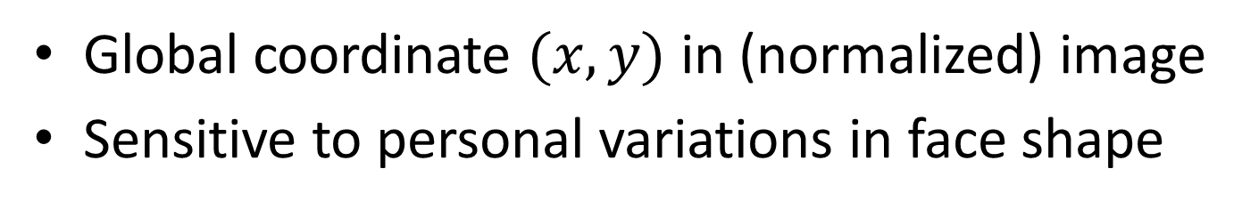

How to index pixels?
$$×$$
Global coordinate $(x, y)$ in (normalized) image
Sensitive to personal variations in face shape

Slide 18
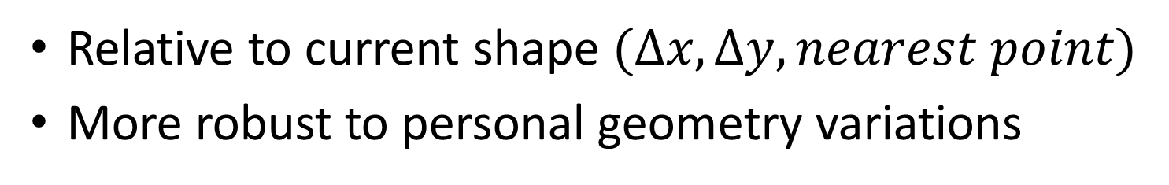

Shape indexed pixels
$$√$$
Relative to current shape $(∆x,∆y, nearest point)$
More robust to personal geometry variations

Slide 19
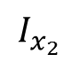
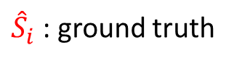

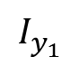
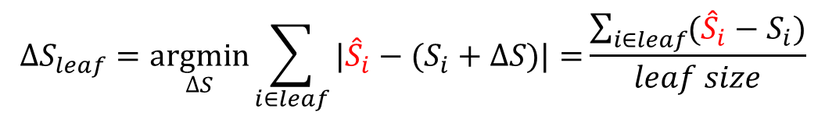
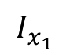
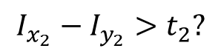
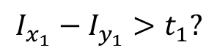
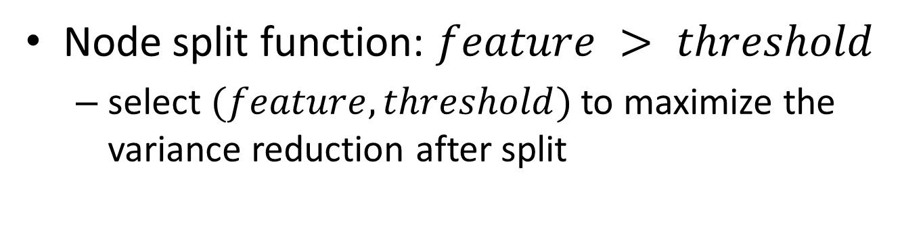


Tree based regressor $r^{k}$
Node split function: $feature > threshold$
select $(feature, threshold)$ to maximize the variance reduction after split
$$I_{x_{1}}−I_{y_{1}}>t_{1}?$$
$$I_{x_{1}}$$
$$I_{x_{2}}−I_{y_{2}}{>t}_{2}?$$
$$I_{x_{2}}$$
$$I_{y_{2}}$$
$$I_{y_{1}}$$
$$∆S_{leaf}=\underset{∆S}{argmin}{\sum_{i∈leaf}{|{\hat{S}}_{i}−(S_{i}+∆S)|}=}\frac{\sum_{i∈leaf}{({\hat{S}}_{i}−S_{i})}}{leaf size}$$
${\hat{S}}_{i}$ : ground truth
$S_{i}$: from last step

Slide 20




Non-parametric shape constraint
$$∆S_{leaf}=\underset{∆S}{argmin}{\sum_{i∈leaf}{|{\hat{S}}_{i}−(S_{i}+∆S)|}=}\frac{\sum_{i∈leaf}{({\hat{S}}_{i}−S_{i})}}{leaf size}$$
$$S^{t}=S^{0}+\sum{w_{i}{\hat{S}}_{i}}$$
$S^{t+1}=S^{t}+$ $∆S$
All shapes $S^{t}$ are in the linear space of all training shapes ${\hat{S}}_{i}$ if initial shape $S^{0}$ is
Unlike PCA, it is learned from data
automatically
coarse-to-fine

Slide 21








Learned coarse-to-fine constraint
Apply PCA (keep $95\%$ variance) to all $∆S_{leaf}$ in each first level stage
#PCs
stage
Stage 1
Stage 10
$\#1$PC
$$\#2 PC$$
$$\#3 PC$$

Slide 22

Regressor learning
$$S^{0}$$
$$R^{1}$$
$$S^{1}$$
$$S^{t−1}$$
$$R^{t}$$
$$S^{t}$$
$$S^{T−1}$$
$$R^{T}$$
$$S^{T}$$
…...
…...
What’s the structure of $R^{t}$
What are the features?
How to select features?

Slide 23

Challenges in feature selection
Large feature pool: $N$ pixels → $N^{2}$ features
N = 400 → 160,000 features
Random selection: pool accuracy
Exhaustive selection: too slow

Slide 24

Correlation based feature selection
Discriminative feature is also highly correlated to the regression target
correlation computation is fast: $O(N)$ time
For each tree node (with samples in it)
Project regression target $∆S$ to a random direction
Select the feature with highest correlation to the projection
Select best threshold to minimize variation after split

Slide 25

More Details
Fast correlation computation
$O(N)$ instead of $O(N^{2})$, $N$: number of pixels
Training data augmentation
introduce sufficient variation in initial shapes
Multiple initialization
merge multiple results: more robust

Slide 26
Performance
#points | 5 | 29 | 87
Training (2000 images) | 5 mins | 10 mins | 21 mins
Testing (per image) | 0.32 ms | 0.91 ms | 2.9 ms
≈300+ FPS
Testing is extremely fast
pixel access and comparison
vector addition (SIMD)

Slide 27
Results on challenging web images
Comparison to [Belhumeur et. al. 2011]
P. Belhumeur, D. Jacobs, D. Kriegman, and N. Kumar. Localizing parts of faces using a concensus of exemplars. In CVPR, 2011.
29 points, LFPW dataset
2000 training images from web
the same 300 testing images
Comparison to [Liang et. al. 2008]
L. Liang, R. Xiao, F. Wen, and J. Sun. Face alignment via component-based discriminative search. In ECCV, 2008.
87 points, LFW dataset
the same training (4002) and test (1716) images

Slide 28


Compare with [Belhumeur et. al. 2011]
Our method is 2,000+ times faster
relative error reduction by our approach
point radius: mean error
5
7
1
6
3
4
8
2
13
15
9
17
11
12
18
10
14
16
21
19
20
22
25
23
26
27
24
better by $>10\%$
better by $<10\%$
worse
28
29

Slide 29

Results of 29 points

Slide 30
Compare with [Liang et. al. 2008]
87 points, many are texture-less
Shape constraint is more important
Mean error | < 5 pixels | < 7.5 pixels | < 10 pixels
Method in [2] | 74.7% | 93.5% | 97.8%
Our Method | 86.1% | 95.2% | 98.2%
percentage of test images with $error<threshold$

Slide 31

Results of 87 points

Slide 32
Summary
Challenges:
Our techniques:
Heuristic and fixed shape model (e.g., PCA)
Large variation in face appearance/geometry
Large training data and feature space
Non-parametric shape constraint
Cascaded regression and shape indexed features
Correlation based feature selection

